Slide 1
Work-Based Learning (WBL) in
College & Career Pathways
David Stern
Graduate School of Education
University of California, Berkeley
College & Career Academy Support Network
http://casn.berkeley.edu
Prepared for presentation to Tri-Valley Educational Collaborative
Livermore
March 5, 2015

Slide 2

Overview
WBL as an element of C&C pathways
Practice for high school students
Forms of WBL

Slide 3
WBL in C&C Pathways
Expand options for students: combine college and career preparation!
WBL is integrated into a multi-year sequence of college-prep and CTE courses.
Students receive personal support.
Cohort scheduling helps with integrating curriculum and with student support.

Slide 4
Pathways that combine these features have been found to improve high school students’ preparation for both
employment
and
postsecondary education

Slide 5
Eight years after high school, MDRC found students assigned to career academies earned 11 percent more than non-academy students.
For males, the difference was 17 percent –– nearly $30,000 over eight years.

Slide 6
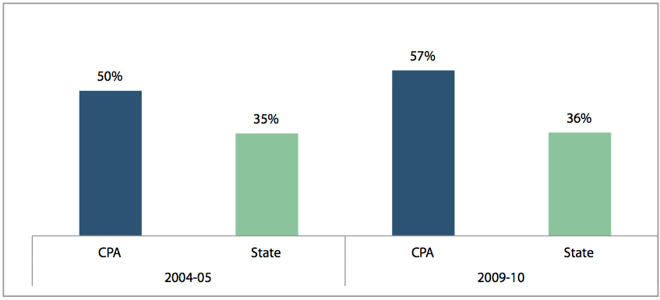
California Partnership Academy graduates exceed state average a-g completion rate

Slide 7
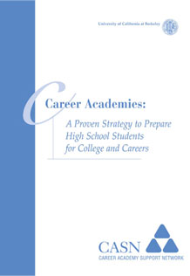
Summary of research on career academies available at http://casn.berkeley.edu

Slide 8
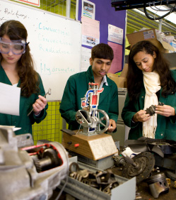
WBL: practice, practice!
How does anyone
get good at baseball,
playing piano, or being
a truck driver, teacher,
or phlebotomist?
Before industrialization
and urbanization,
children learned to
work by working
alongside adults.

Slide 9
What should high school students practice?
Specific job skills and procedures
And, for long-term career success, various social and emotional capabilities

Slide 10
What are social and emotional capabilities?
Longitudinal studies that have measured certain things like self-esteem, locus of control, and planfulness in young people have found these predict career success several decades later.
These correlations are independent of years of schooling and measures of cognitive achievement.

Slide 11
More opinions than evidence
Longitudinal studies don’t give us a complete list, or tell us which are most important.
Various lists have been proposed: SCANS (1991), soft skills (Levy and Murnane, 1996), 21st century skills, scout virtues….
But no one can say which of these will be most important in workplaces several decades from now.

Slide 12
What high schools should do…
Do:
  Engage students in learning through work where they take responsibility for meeting demands of real clients or customers.
  Evaluate students’ performance by standards of adult professional work.

Slide 13
Do:
  Ensure that students’ work affords opportunity to develop various social and emotional capabilities such as collaboration with coworkers of different ages, communication with clients and customers, taking initiative, confronting unanticipated problems, setting priorities, etc.
  Include successful performance in WBL as a metric in LCAPs!

Slide 14
…and not do
Don’t:
  Rely on “career readiness” tests that have not been shown to predict actual success at work.

Slide 15
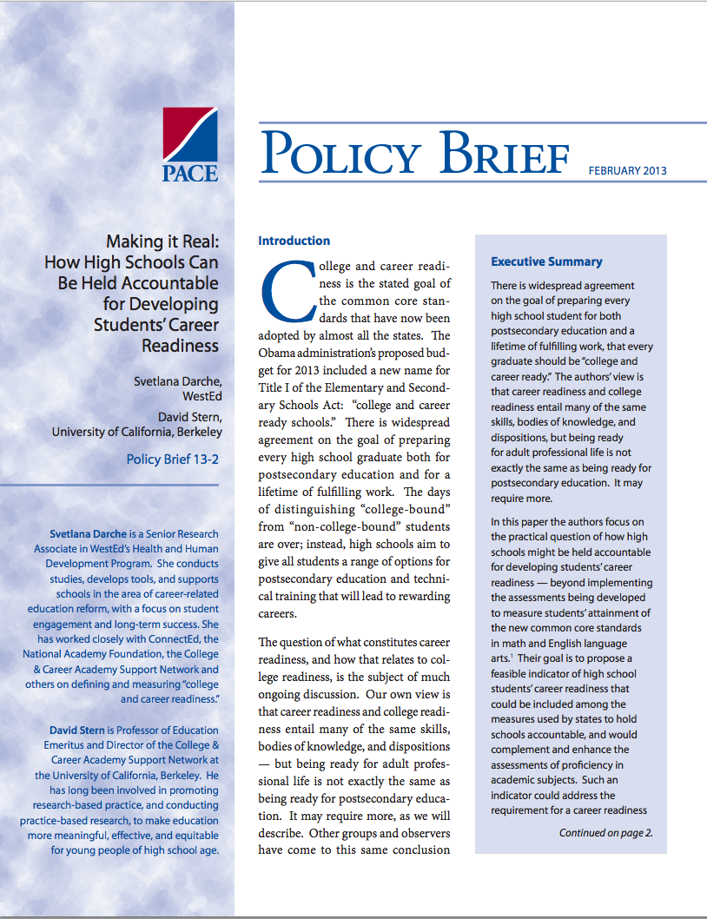
Summary of research on WBL
(Darche and Stern) available at http://casn.berkeley.edu

Slide 16

Forms of WBL
Learning through work:
school-based enterprise, e.g. construction, retail, apps, media, food, manufacturing, studies for civic clients, etc.
internships, paid or unpaid

Slide 17
Work-Based Learning Continuum
Career Awareness
Learning ABOUT work.
Career Preparation: Practicum & Internships
Learning THROUGH work.
Career Training
Learning FOR work.
Career Exploration
Learning ABOUT work.
Internship required for credential or entry to occupation
Apprenticeship
Job shadow
Clinical experience
Career fair
Virtual exchange with a partner
On-the-job training
Explore career options and post-secondary requirements for purpose of motivation and to inform decision-making in high school and post-secondary.
Guest speaker
Workplace tour
Build awareness of the variety of careers available and the role of post-secondary education; Broaden student options.
Sample Student Learning Outcome:
Student can articulate the type of post-secondary education and training required in the career field and its importance to success in that field.
Experience Defined by:
Experiences might include:
Sample Student Learning Outcome
Student can give at least two examples of how the student’s individual skills and interests relate to the career field and/or occupations.
Experience Defined By:
Personalized to connect to emerging student interests.
Experiences might include:
Apply learning through practical experience that develops knowledge and skills necessary for success in careers and post-secondary education.
Integrated project with multiple interactions with professionals
Student-run enterprise with partner involvement
Virtual enterprise or other extended online interactions with partners
Sample Student Learning Outcome
Student builds effective collaborative working relationships with colleagues and customers; is able to work with diverse teams, contributing appropriately to the team effort;
An Experience Differentiated By:
Direct interaction with partners over time
Train for employment and/or post-secondary education in a specific range of occupations.
Sample Student Learning Outcome
Student demonstrates knowledge and skills specific to employment in a range of occupations in a career field.
An Experience Differentiated By:
Interaction with partners over extended period of time.
Experiences might include:
Application of skills transferable to a variety of careers
One-time interaction with partner(s), often for a group of students
Experiences might include:
One-time interaction with partner(s) for a single student or small group
Builds skills necessary for in-depth work-based learning
Projects with partners through industry student organizations
Work experience
Informational interview
Compensated internship connected to curriculum
Designed primarily by adults to broaden student’s awareness of a wide variety of careers and occupations
Depth in particular career fields.
Student takes an active role in selecting and shaping the experience
Activities have consequences and value beyond success in the classroom.
Benefit to the partner is primary and learning for student is secondary.
Learning for student and benefit to partner are equally valued
Develop mastery of occupation specific skills.
Complete certifications or other requirements of a specific range of occupations.
Visit parents at work
Service learning and social enterprises with partners

